Slide 1
FRAMES

Slide 2
INTRODUCTION
FRAMES: the HTML tags that divide a browser screen into two or more HTML recognizing unique regions .
Tag used is the <FRAMESET>..</FRAMESET> tags.
Each unique region is called a frame.
Each frame can be loaded with a different document and hence, allow multiple HTML documents to be seen concurrently.

Slide 3
FRAMESET tag: this tag is included after <HEAD> tag . This is a paired tag.
  <FRAMESET COLS=“width1,width2, ” ROWS=“height1,height2”>
  ….. Frame or frameset definitions…..
  </FRAMESET>
Cols: this attribute is used for vertical frames and widths are specified as a comma delimited list of sizes in pixels, %age, or as a proportion of the remaining space by using ‘*’.
Rows: this attribute is used for horizontal frames and height again is specified in pixels ,%age or as a proportion of the remaining space by using ‘*’.
Attributes:
  Border/ FrameBorder: value 0 will turn off the border and value 1 will turn it on. To increase the border width change the value of border.
  bordercolor: to set the frame border color to a specified color.

Slide 4
FRAME: this tag contains the frame content. It tells the browser, what to put in each frame. Each frameset must include a <FRAME> definition for each division. It is a singular tag.
Attributes:
  Src: indicates the URL of the document to be loaded into the frame.
  MarginHeight: specifies the amount of white space to be left at the top and bottom of the frame.
  MarginWidth: specifies the amount of white space to be left along the sides of the frame.
  Name: gives the frame a unique name so it can be targeted by other documents. The name given must be given with an alphanumeric character.
  Noresize: disables the frame resizing capability.
  Scrolling: controls the appearance of horizontal and vertical scrollbars in a frame. This takes the value YES/NO/AUTO.

Slide 5
<html>
<head><title> FRAMING TAGS</title></head>
<frameset cols="50%,50%">
<frame src="form.html">
<frame src="1.html">
</frameset>
</html>

Slide 6
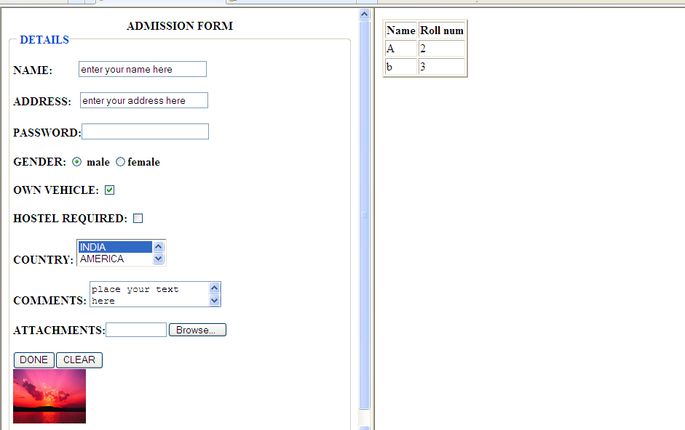

Slide 7
<html>
<head><title> FRAMING TAGS</title></head>
<frameset cols="40%,30%,30%">
<frame src="form.html">
<frame src="1.html">
<frame src="table.html">
</frameset>
</html>

Slide 8
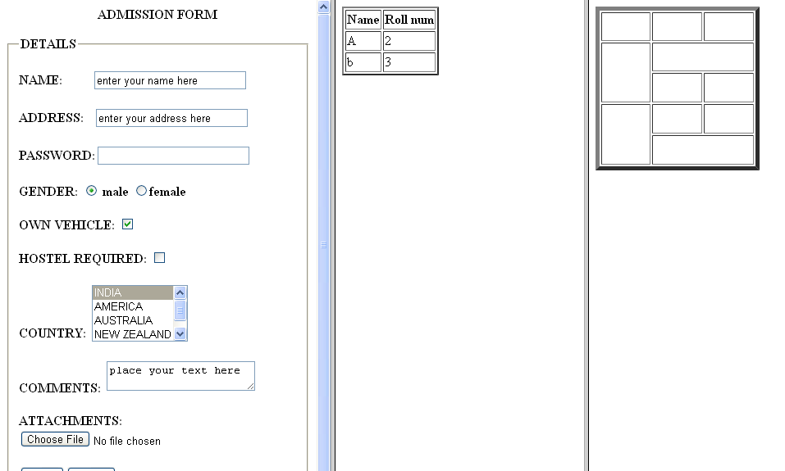

Slide 9
<html>
<head><title> FRAMING TAGS</title></head>
<frameset rows="40%,30%,30%">
<frame src="form.html">
<frame src="1.html">
<frame src="table.html">
</frameset>
</html>

Slide 10
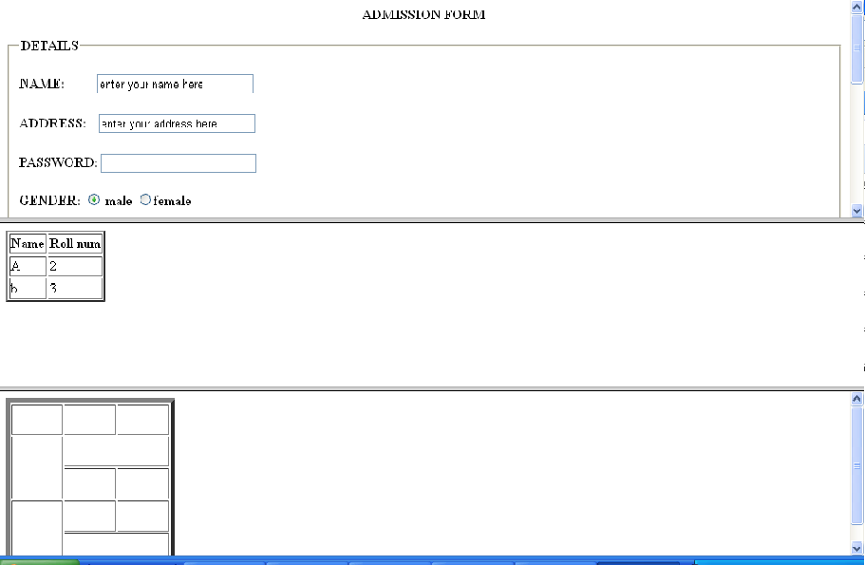

Slide 11
Elastic Frames
The height/ width of frames can be specified in terms of number of pixels. In elastic frames we use the notation * instead of a number. The ‘*’ means whatever is left over.
<html>
<head><title> FRAMING TAGS</title></head>
<frameset rows="200,*,*">
<frame src="form.html">
<frame src="1.html">
<frame src="table.html">
</frameset>
</html>

Slide 12
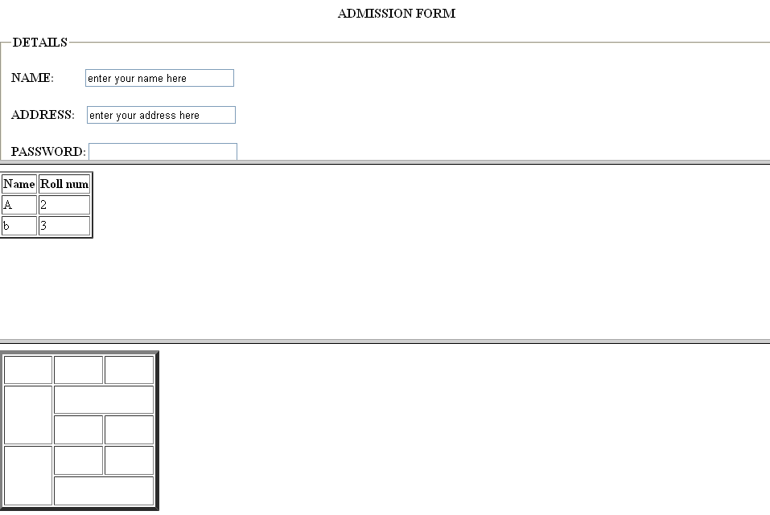

Slide 13
NESTED FRAME SETS
Combinations of rows and columns
<html>
<head><title> FRAMING TAGS</title></head>
<frameset rows="200,*,*">
<frame src="form.html">
<frameset cols="*,*">
<frame src="1.html">
<frame src="table.html">
</frameset>
<frame src="form.html">
</frameset>
</html>

Slide 14
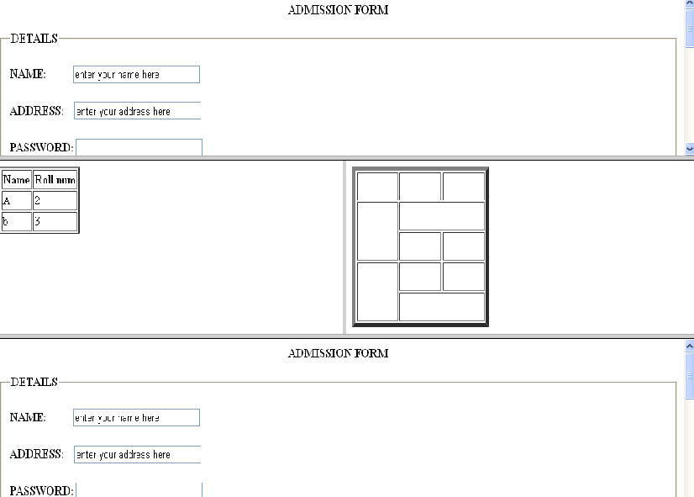

Slide 15
BORDER
If value id set to 0 then frame will be without border.
If value is some positive number then the border size will increase as per the value.
<html>
<head><title> FRAMING TAGS</title></head>
<frameset border=0 rows="200,*,*">
<frame src="form.html">
<frameset cols="*,*">
<frame src="1.html">
<frame src="table.html">
</frameset>
<frame src="form.html">
</frameset>
</html>

Slide 16
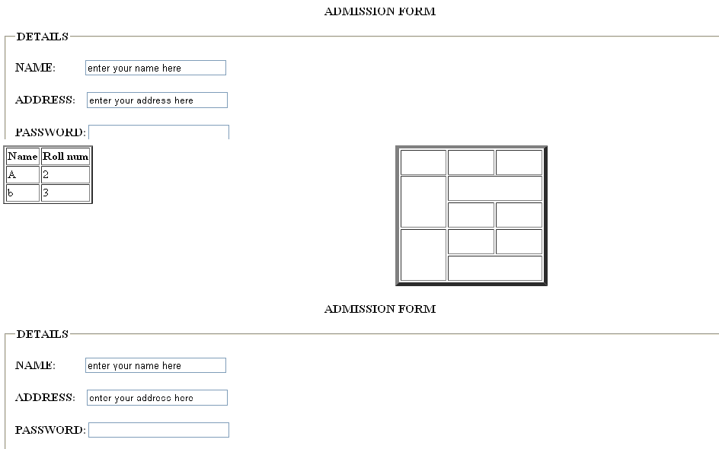

Slide 17
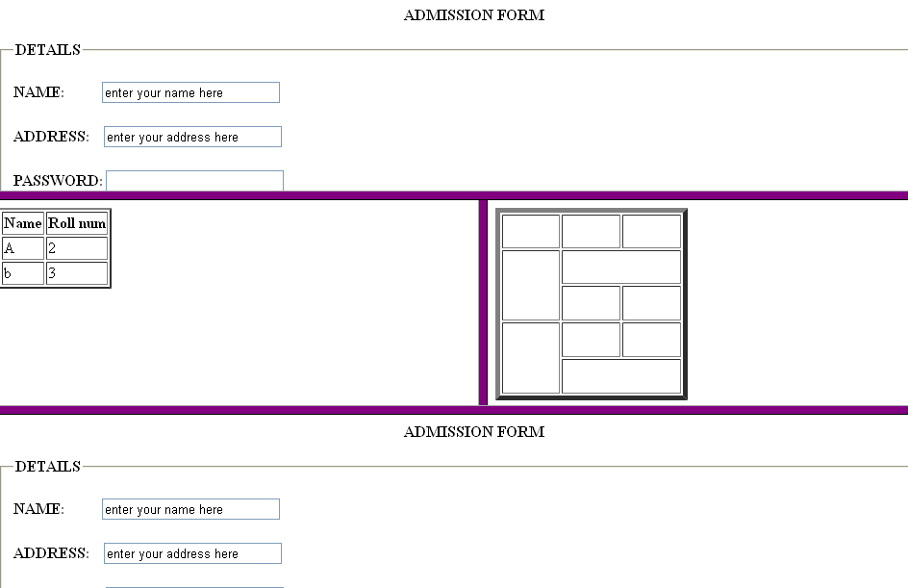
BORDER COLOR= purple

Slide 18
Frame margins : Frame tag
Margin is the space between frame edge and the frame content.
By default browser automatically gives each frame some empty space around its contents.
It accept the value in pixels as the amount of space to be left as margins.
<html>
<head><title> FRAMING TAGS</title></head>
<frameset border=10 bordercolor="purple" rows="200,*,*">
<frame src="form.html" marginwidth=0>
<frame src="1.html" marginwidth=50>
<frame src="table.html" marginwidth=100>
</frameset>
</html>

Slide 19
